Slide 1
LISTS and ARRAYS

Slide 2
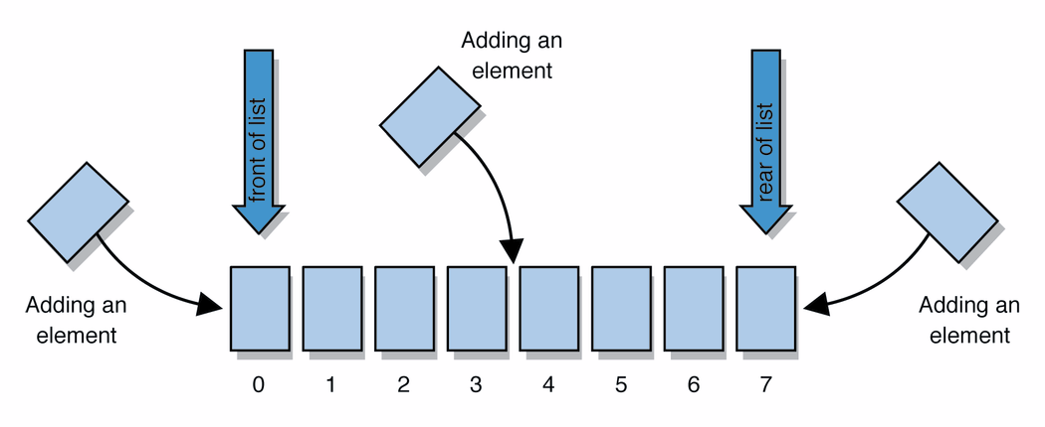
Lists
list: a collection storing an ordered sequence of elements
each element is accessible by a 0-based index
a list has a size (number of elements that have been added)
elements can be added to the front, back, or elsewhere
in Java, a list can be represented as an ArrayList object
Notes:
use jGRASP Interactions window to create a list and add some elements, get them, check size

Slide 3
Idea of a list
Rather than creating an array of boxes, create an object that represents a "list" of items. (initially an empty list.)
[]
You can add items to the list.
The default behavior is to add to the end of the list.
[hello, ABC, goodbye, okay]
The list object keeps track of the element values that have been added to it, their order, indexes, and its total size.

Slide 4
Array vs ArrayList
In Java, following are two different ways to create an array.
Array:
Simple fixed sized arrays that we create in Java, like below
int arr[] = new int[10]
ArrayList :
Dynamic sized arrays in Java that implement List interface.
ArrayList<Type> arrL = new ArrayList<Type>();
Here Type is the type of elements in ArrayList tobe created

Slide 5
ArrayList methodS
add(value) | appends value at end of list
add(index, value) | inserts given value just before the given index, shifting subsequent values to the right
clear() | removes all elements of the list
indexOf(value) | returns first index where given value is found in list (-1 if not found)
get(index) | returns the value at given index
remove(index) | removes/returns value at given index, shifting subsequent values to the left
set(index, value) | replaces value at given index with given value
size() | returns the number of elements in list
toString() | returns a string representation of the list such as "[3, 42, -7, 15]"

Slide 6
ArrayList methods
addAll(list) addAll(index, list) | adds all elements from the given list to this list (at the end of the list, or inserts them at the given index)
contains(value) | returns true if given value is found somewhere in this list
containsAll(list) | returns true if this list contains every element from given list
equals(list) | returns true if given other list contains the same elements
iterator() listIterator() | returns an object used to examine the contents of the list
lastIndexOf(value) | returns last index value is found in list (-1 if not found)
remove(value) | finds and removes the given value from this list
removeAll(list) | removes any elements found in the given list from this list
retainAll(list) | removes any elements not found in given list from this list
subList(from, to) | returns the sub-portion of the list between indexes from (inclusive) and to (exclusive)
toArray() | returns the elements in this list as an array

Slide 7
Type Parameters (Generics)
List<Type> name = new ArrayList<Type>();
When constructing an ArrayList, you must specify the type of elements it will contain between < and >.
This is called a type parameter or a generic class.
Allows the same ArrayList class to store lists of different types.
List<String> names = new ArrayList<String>();
names.add("Marty Stepp");
names.add("Stuart Reges");

